Slide 1



















Module 4 Semiconductor devices

Slide 2


1. semiconductor theory

Slide 3
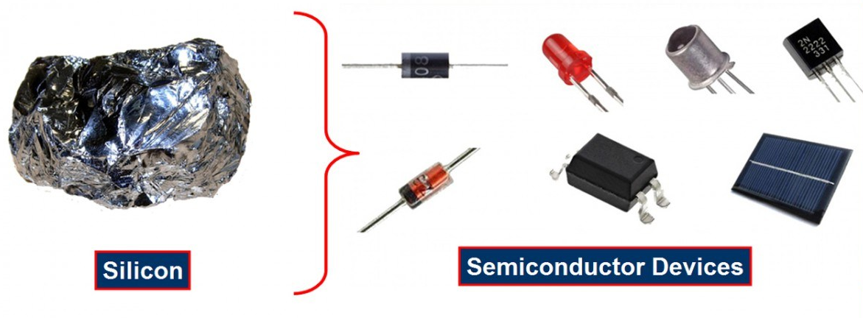













Semiconductor Devices

Slide 4

Semiconductor Devices
Electronic Devices are all about handling information i.e. high-speed transmission, acquisition and processing in fields of industries and manufacturing, communications, arts, medicine and even in warfare.
Even though an electronic system is manufactured with the help of conductors, insulators and semiconductors, the semiconductors are considered the backbone of electronics.
Over the last 70 years, semiconductors became a crucial element in the manufacturing of electronics.
The Semiconductor device is made up of a material that is neither a good conductor nor a good insulator, it is called a semiconductor.
Such devices have established wide applications because of their reliability, compactness, and low cost.

Slide 5
Semiconductor devices
These are discrete components which are used in power devices, compactness optical sensors, and light emitters, including solid-state lasers.
They have a wide range of current and voltage handling capabilities, with current ratings more than 5,000 amperes and voltage ratings more than 100,000 volts.
Semiconductor devices are nothing but electronic components that exploit the electronic properties of semiconductor materials, like as silicon, germanium, and gallium arsenide, as well as organic semiconductors.

Slide 6
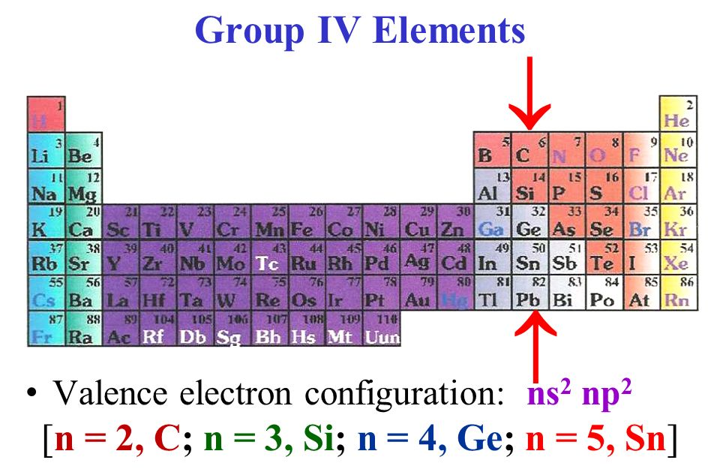

Semiconductor material
Traditionally, group IV elements like Silicon (Si) and Germanium (Ge) are considered the Elemental Semiconductor Materials i.e. semiconductors with only single atom species.

Slide 7
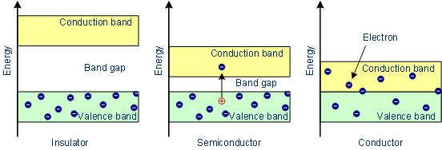
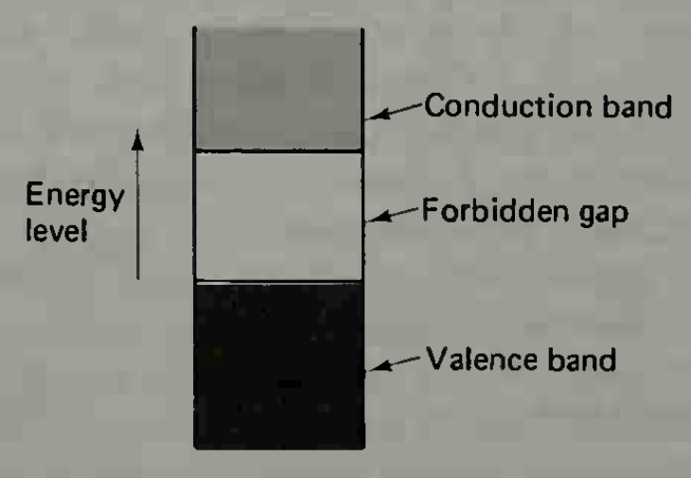

Semiconductor Material
As seen from the energy band diagrams, insulator have a wide forbidden band gap, semiconductors have a narrow forbidden band gap and conductors have no forbidden band gap.

Slide 8
Semiconductor material
In case of Insulators, there are practically no electron in the conduction band of energy levels, and the valance band is filled. Also, the forbidden gap is so wide that it would require the application of very large amount of energy to cause an electron to cross from the valance band to conduction band.
For semiconductors, the valance band is usually full and there may be no electron in the conduction band. The semiconductor forbidden gap is very narrow than that of insulator, and the application of small amounts of energy can raise electrons from valance band to the conduction band.
In case of conductors, there is no forbidden gap, and the valance and conduction bands overlap. For this reason, very large number of electrons are available for conduction.

Slide 9





















Semiconductor material
Semiconductor materials are useful by their behaviour which can be easily manipulated by the addition of impurities is known as doping.
Doping is generally performed to the semiconductor materials, where an impurity is introduced into its structure to change the structural as well as electrical properties.
A pure semiconductor is known as Intrinsic Semiconductor while an impure or doped semiconductor is known as Extrinsic Semiconductor.
When the number of free electrons in the semiconductor structure is increased after doping, the semiconductor is known as n-type semiconductor. Similarly, if the holes are increased, it is known as p-type semiconductor.

Slide 10




Types of Semiconductor Devices
The following is a small list of some of the commonly used semiconductor devices. Based on the physical structure of the device, the following list is categorized into Two-terminal Devices and Three-terminal Devices.
Two-terminal Semiconductor Devices: Diode, Schottky Diode, Light Emitting Diode (LED), DIAC, Zener Diode etc
Three-terminal Semiconductor Devices: Bipolar Transistor, Field Effect Transistor, Insulated Gate Bipolar Transistor (IGBT) etc
There are also a few four-terminal semiconductors like Optocoupler (Photocoupler) and Hall-effect Sensor.

Slide 11





2. PN Junction
Basics of a PN Junction,
How a PN Junction is formed,
Characteristics of PN Junction

Slide 12
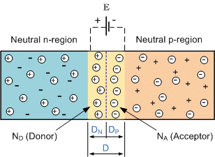







PN Junction Theory
A PN-junction is formed when an N-type material is fused together with a P-type material creating a semiconductor diode
However, if we join (or fuse) these two semiconductor materials together they behave in a very different way merging together and producing what is generally known as a “PN Junction”.
When the N-type semiconductor and P-type semiconductor materials are first joined together a very large density gradient exists between both sides of the PN junction.
The result is that some of the free electrons from the donor impurity atoms begin to migrate across this newly formed junction to fill up the holes in the P-type material producing negative ions.

Slide 13




PN Junction Theory
However, because the electrons have moved across the PN junction from the N-type silicon to the P-type silicon, they leave behind positively charged donor ions ( ND ) on the negative side and now the holes from the acceptor impurity migrate across the junction in the opposite direction into the region where there are large numbers of free electrons.
As a result, the charge density of the P-type along the junction is filled with negatively charged acceptor ions (NA), and the charge density of the N-type along the junction becomes positive.
This charge transfer of electrons and holes across the PN junction is known as diffusion.
The width of these P and N layers depends on how heavily each side is doped with acceptor density NA, and donor density ND, respectively.

Slide 14





PN Junction Theory
This process continues back and forth until the number of electrons which have crossed the junction have a large enough electrical charge to repel or prevent any more charge carriers from crossing over the junction.
Eventually a state of equilibrium (electrically neutral situation) will occur producing a “potential barrier” zone around the area of the junction as the donor atoms repel the holes and the acceptor atoms repel the electrons.
Since no free charge carriers can rest in a position where there is a potential barrier, the regions on either sides of the junction now become completely depleted of any more free carriers in comparison to the N and P type materials further away from the junction.
This area around the PN Junction is now called the Depletion Layer.

Slide 15
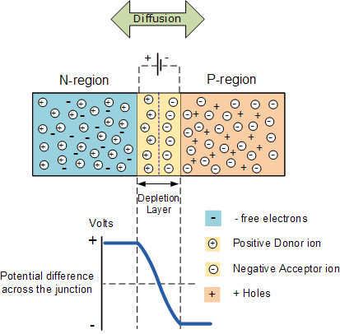











The PN junction
The total charge on each side of a PN Junction must be equal and opposite to maintain a neutral charge condition around the junction.
If the depletion layer region has a distance D, it therefore must therefore penetrate into the silicon by a distance of Dp for the positive side, and a distance of Dn for the negative side giving a relationship between the two of:
Dp*NA = Dn*ND
in order to maintain charge neutrality also called equilibrium.

Slide 16
3. PN Junction Diode

Slide 17






















PN Junction Diode
Diode is a semiconductor device, which conduct the current in one direction only. Two terminals: anode and cathode.
Construction of Diode
In a piece of semiconductor material, if one half is doped by P-type and the other half is doped by N-type impurity, a PN junction is formed. The plane dividing the two halves or zones is called PN junction.
The N-type has high concentration of free electrons while P-type has high concentration of holes. Therefore at the junction there is a tendency for the free electrons to diffuse over to the P-side and holes to the N-side (process called diffusion).
The net opposite charge in each layer prevents further diffusion into that layer. Thus a barrier is set up near the junction which prevents further movement of charge carriers. This is called as potential barrier (0.3V or germanium and 0.7V for silicon).

Slide 18












Symbol, circuit diagram and V-I characteristics of Diode

Slide 19
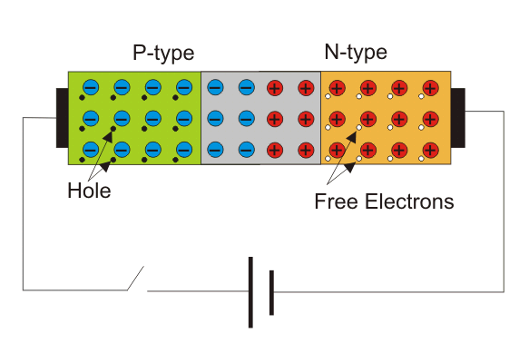






Working of Diode - Unbiased Diode
N-side will have a significant number of free electrons, and very few holes (due to thermal excitation) whereas the p side will have a high concentration of holes and very few free electrons.
Due to this, a process called diffusion takes place.
In this process free electrons from n side will diffuse (spread) into the p side and recombine with holes present there, leaving positive immobile (not moveable) ions in n side and creating negative immobile ions in the p-type side of the diode.
The region is called as depletion region due to the “depletion” of free carriers in the region.
Due to the presence of these positive and negative ions a static electric field called as barrier potential is created across the PN junction of the diode.
It is called "barrier potential" because it acts as a barrier and opposes the further migration of holes and free electrons across the junction.

Slide 20
Working of Diode - biased Diode
Forward Biased
Reverse Biased

Slide 21
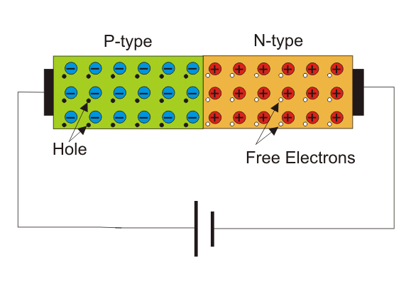

Forward Biased Diode
When the positive polarity of supply is connected to the anode – the diode is forward biased and it conducts.
If forward applied voltage increases from zero, the diode will start conducting only applied the voltage reaches just above the barrier potential or forward biased voltage of the junction.

Slide 22
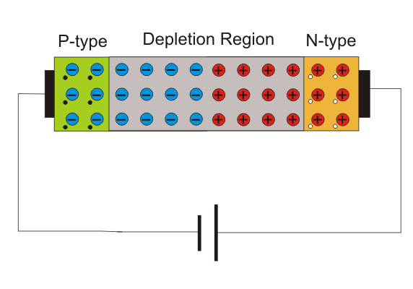





Reverse Biased Diode
When the positive polarity of supply is connected to the cathode – the diode is reversed biased and it does not conduct.
If the reverse-biasing voltage is sufficiently large than breakdown voltage, the diode is in reverse-breakdown region and large current flows though it.
As the magnitude of the reverse voltage increases, the kinetic energy of the minority charge carriers also increase.
These fast-moving electrons collide with the other atoms in the device to knock-off some more free electrons from them.
The free electrons so released further release much more free electrons from the atoms by breaking the covalent bonds.
This process is termed as carrier multiplication and leads to a considerable increase in the flow of current through the p-n junction.
The associated phenomenon is called Avalanche Breakdown.

Slide 23
4. Application of Diode - Rectifiers
Halfwave Rectifier & Full Wave Rectifier

Slide 24




Rectifiers
The main application of p-n junction diode is in rectification circuits.
These circuits are used to describe the conversion of a.c signals to d.c in power supplies.
Diode rectifier gives an alternating voltage which pulsates in accordance with time.
The filter smoothes the pulsation in the voltage and to produce d.c voltage, a regulator is used which removes the ripples.
There are two primary methods of diode rectification:
Half Wave Rectifier
Full Wave Rectifier

Slide 25
Half Wave Rectifier
In a half-wave rectifier, one half of each a.c input cycle is rectified.
When the p-n junction diode is forward biased, it gives little resistance and when it is reversing biased it provides high resistance.
During one-half cycles, the diode is forward biased when the input voltage is applied and in the opposite half cycle, it is reverse biased.
During alternate half-cycles, the optimum result can be obtained.

Slide 26
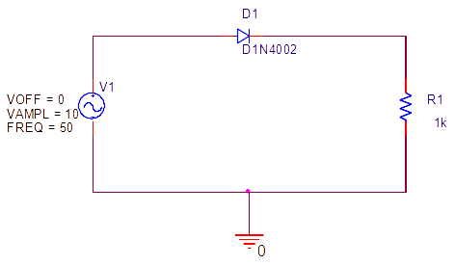
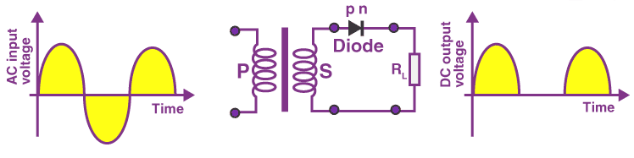


Working of Half Wave Rectifier
The half-wave rectifier has both positive and negative cycles.
During the positive half of the input, the current will flow from positive to negative which will generate only a positive half cycle of the a.c supply.
In the second half cycle, the current will flow from negative to positive and the diode will be reverse biased.
Thus, at the output side, there will be no current generated, and we cannot get power at the load resistance.

Slide 27
Characteristics of Half Wave Rectifier
1. Ripple Factor
2. DC Current
3. DC Output Voltage
4. Form factor
5. Rectifier Efficiency
Advantages
Disadvantages
Applications

Slide 28

Half Wave Rectifier – Ripple Factor
Ripples are the oscillations that are obtained in DC which is corrected by using filters such as inductors and capacitors.
These ripples are measured with the help of the ripple factor and are denoted by γ. Ripple factor tells us the number of ripples presents in the output DC.
Higher the ripple factor, more is the oscillation at the output DC and lower is the ripple factor, less is the oscillation at the output DC.
Ripple factor is the ratio of RMS value of the AC component of the output voltage to the DC component of the output voltage.

Slide 29


Half Wave Rectifier – Characteristics
DC Current
Imax is the maximum DC load current
DC Output Voltage
The output DC voltage appears at the load resistor RL which is obtained by multiplying output DC voltage with the load resistor RL.
The output DC voltage is given as:
VSmax is the maximum secondary voltage
Form Factor
The form factor is the ratio of RMS value to the DC value. For a half-wave rectifier, the form factor is 1.57.
Rectifier Efficiency
Rectifier efficiency is the ratio of output DC power to the input AC power. For a half-wave rectifier, rectifier efficiency is 40.6%.

Slide 30
Advantages of Half Wave Rectifier
Affordable
Simple connections
Easy to use as the connections are simple
Number of components used are less
Disadvantages of Half Wave Rectifier
Ripple production is more
Harmonics are generated
Utilization of the transformer is very low
The efficiency of rectification is low
Applications of Half Wave Rectifier
Power rectification: Half wave rectifier is used along with a transformer for power rectification as powering equipment.
Signal demodulation: Half wave rectifiers are used for demodulating the AM signals.
Signal peak detector: Half wave rectifier is used for detecting the peak of the incoming waveform.

Slide 31
Full Wave Rectifier
Full-wave rectifier circuits are used for producing an output voltage or output current which is purely DC.
The main advantage of a full-wave rectifier over half-wave rectifier is that such as the average output voltage is higher in full-wave rectifier, there is less ripple produced in full-wave rectifier when compared to the half-wave rectifier.
The full-wave rectifier utilizes both halves of each a.c input. When the p-n junction is forward biased, the diode offers low resistance and when it is reversing biased it gives high resistance.
The circuit is designed in such a manner that in the first half cycle if the diode is forward biased then in the second half cycle it is reverse biased and so on.

Slide 32
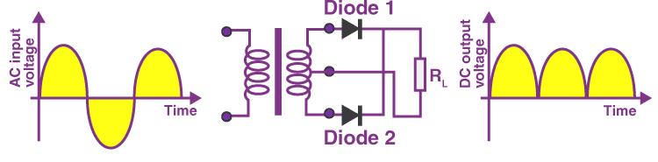
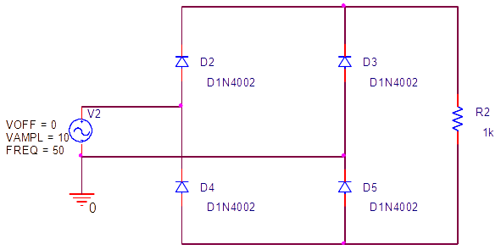




Full wave rectifier

Slide 33



Characteristics of Full Wave Rectifier
Ripple Factor
DC Current
DC Output Voltage
Form Factor - The form factor of a full-wave rectifier is given as 1.11
Rectifier Efficiency - The rectifier efficiency of a full-wave rectifier is 81.2%.
Types of Full Wave Rectifier
There are two main types of full-wave rectifiers, and they are:
Two diodes full-wave rectifier circuit (requires a center-tapped transformer and is used in vacuum tubes)
Bridge rectifier circuit (doesn’t require a centre-tapped transformer and is used along with transformers for efficient usage)

Slide 34
Advantages of Full Wave Rectifier
The rectifier efficiency of a full-wave rectifier is high
The power loss is very low
Number of ripples generated are less
Disadvantages of Full Wave Rectifier
Very expensive
Applications of Full Wave Rectifier
Following are the uses of full-wave rectifier:
Full-wave rectifiers are used for supplying polarized voltage in welding and for this bridge rectifiers are used.
Full-wave rectifiers are used for detecting the amplitude of modulated radio signals.

Slide 35
